Slide 1
Crossplatform Mobile Apps With HTML SCSS and Angular2
Agastya Darma Laksana Modern JavaScript Evangelist @gedeagas on GitHub www.agastyadarma.com

Slide 2
Do you know HTML / CSS ?
How About Angular2 ?

Slide 3
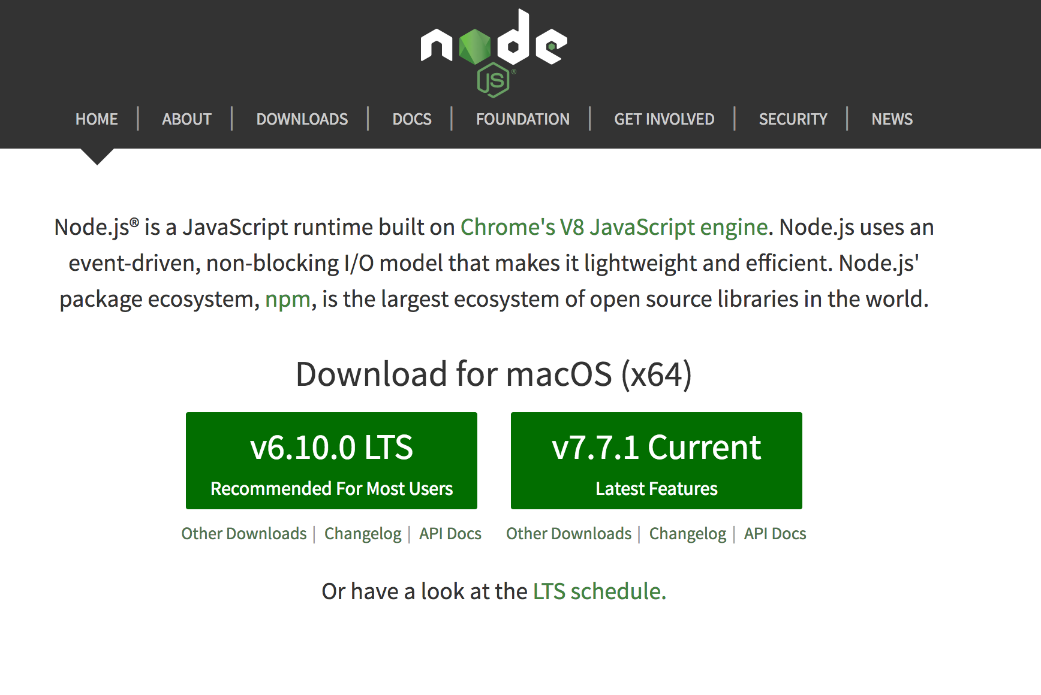
How About Angular2 ?

Slide 4
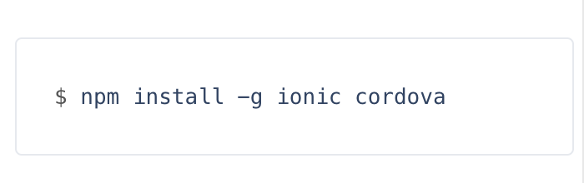
How to install ?

Slide 5
What Next ?

Slide 6
Crossplatform Mobile Apps With HTML SCSS and Angular2
Agastya Darma Laksana @gedeagas

